Slide 1
Deep Learning in Human Language Technology 2020
Convolutional Neural Networks
(ConvNets or CNNs)
TurkuNLP: https://turkunlp.github.io/
2020/03/17
By: Farrokh Mehryary

Slide 2
Content
Page:1
Order of words
Presenting words with order to neural networks
Convolutional Neural Networks - Introduction
Main concepts in CNN architectures
Convolution operation
Non-linearity (ReLU)
Pooling layers
Fully connected layers, decision layer
CNNs for textual data
What do filters learn?

Slide 3
Order of words
Page:2
Bag-Of-Words approach does not take into account the order of words.
Order of words in some cases and for some NLP applications matters!
Example:
I had my car cleaned. (implies that someone else did it!)
I had cleaned my car.
Example:
Only he said, “I love you.” (No one else said it.)
He only said, “I love you.” (He said nothing else.)
He said, “only I love you.” (No one else does.)
He said, “I love only you.” (He doesn’t love anyone else.)
He said, “I love you only.” (His love is exclusive.)
Example:
King_X was killed by John_Y in 1628.
John_Y was killed by King_X in 1628.
Example:
Gene_A regulates Gene_B.
Gene_B regulates Gene_A.

Slide 4
Order of words
Page:3
Present words with order to the neural network (inputs are indices of words in the word-embeddings model)
Embedding of the 1st word
Embedding of the 2nd word
Sequence of word-embeddings
as a matrix
Word-embeddings lookup layer
Sequence of word-indices as input vector
Index of the 1st word
Index of the 2nd word ...
Index of the last word

Slide 5
Order of words
Page:4
I
I
had
had
cleaned
my
my
car
car
cleaned
masked
masked
I, had, cleaned, my, car
I_had, had_cleaned, cleaned_my, my_car
I_had_cleaned, had_cleaned_my, cleaned_my_car
I_had_cleaned_my, had_cleaned_my_car
I_had_cleaned_my_car
I, had, my, car, cleaned
I_had, had_my, my_car, car_cleaned
I_had_my, had_my_car, my_car_cleaned
I_had_my_car, had_my_car_cleaned
I_had_my_car_cleaned

Slide 6
Order of words
Page:5
Main ANN architectures that utilize word order:
Convolutional Neural Networks (ConvNets/CNNs) (this week)
Recurrent Neural Networks (RNNs)
RNNs
Long Short-Term Memory networks (LSTMs)
Gated Recurrent Units (GRUs)

Slide 7
Convolutional Neural Networks
Page:6
Convolutional Neural Networks (ConvNets / CNNs)
Originally were developed for image classification and computer vision, but during the past decade have been successfully used for many NLP and text mining tasks.
A variant of deep feedforward neural networks.
Much easier to train compared to RNNs (CNNs are very fast to train!)
Inspired by the biological visual cortex in the brain. The cortex has small regions of cells that are sensitive to the specific areas of the visual field. (See [1,2])

Slide 8
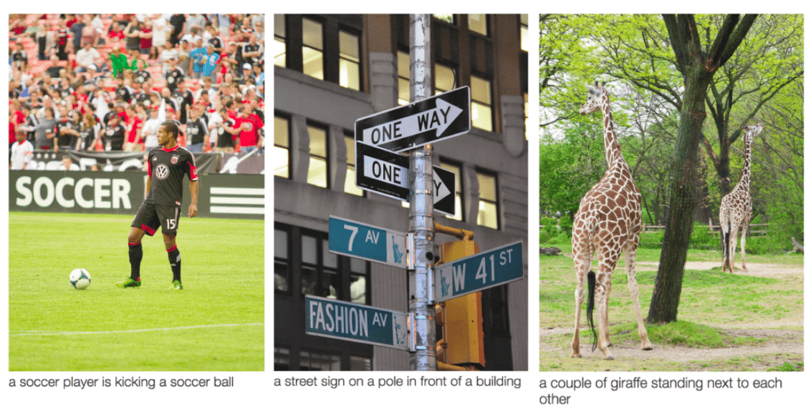
Convolutional Neural Networks
Page:7
CNNs can automatically suggest captions for images! [4]

Slide 9
Convolutional Neural Networks
Page:8
Applications of CNNs in NLP:
Text classification (See [5 , 11])
Named Entity Recognition (See [12])
Part-of-Speech Tagging (See [13])
Semantic parsing and question answering (See [14])
Phrase detection (See [15])
Document summarization (See [16])
Machine translation (See [17, 18])
Speech recognition (See [19])
Writing correction (See [20, 21])
Relation extraction (See [22, 23, 24])

Slide 10
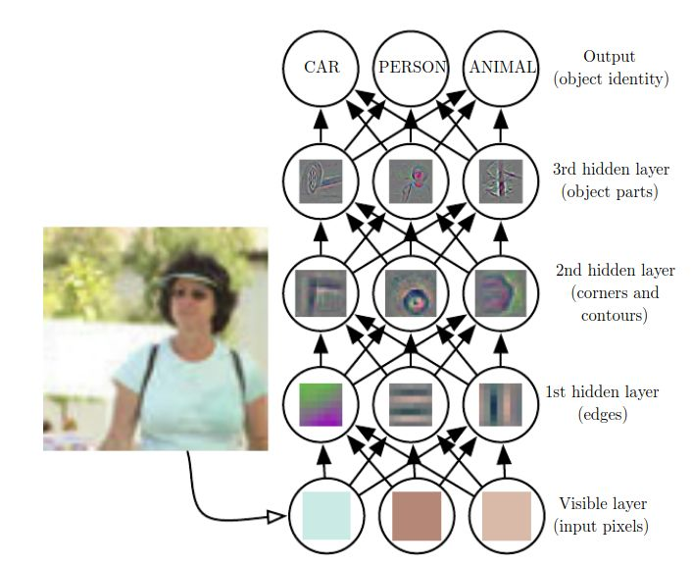
Convolutional Neural Networks
Page:9
Major benefit of deep feedforward neural nets:
Require much less feature-engineering,
since more complex concepts
(representations) are automatically
learnt from simpler concepts,
layer by layer [3].
Words —> phrases —> sentences

Slide 11
Convolutional Neural Networks
Page:10
Problems of fully-connected feedforward deep neural networks:
Example: a simple feed-forward network for image classification
A 200x200 pixel colour image
each pixel is represented by 3 values for Red, Green, Blue.
—> 200*200*3 = 120,000 input values
Connect to a 1000 dimensional fully connected hidden layer —>
120,000 * 1000 = 120,000,000 weights! Each weight is a 4 byte float32 number.
Problem 1: 120,000,000 * 4 bytes = 0.48 GBytes of RAM!
Problem 2: may lead to overfitting!

Slide 12
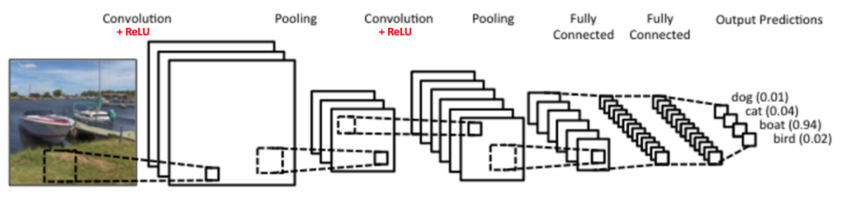
Convolutional Neural Networks
Page:11
Convolutional Neural Networks (ConvNets / CNNs)
Have many fewer learnable parameters (weights) than fully connected networks with the same number of hidden units. [6]

Slide 13

Convolutional Neural Networks
Page:12
Main concepts in ConvNets architecture:
Convolution
Non-linearity (ReLU)
Pooling or Subsampling
Fully Connected layer(s)
Decision layer
Image from [7]

Slide 14

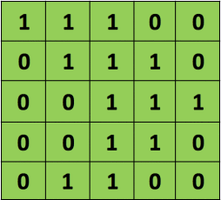
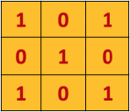
Convolutional Neural Networks
Page:13
Main concepts in ConvNets architecture:
Convolution operation
The primary purpose of Convolution is to extract features from the input image.
Convolution preserves the spatial relationship between pixels by learning image features
using small squares of input data. [8]
Stride = 1
3x3 filter or kernel or
feature detector matrix
5x5 matrix
(original image)
(feature map matrix)

Slide 15

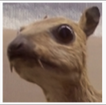
Convolutional Neural Networks
Page:14
Main concepts in ConvNets architecture:
Convolution operation
Different values of the filter matrix
will produce different Feature Maps
for the same input image. [8]

Slide 16

Convolutional Neural Networks
Page:15
Main concepts in ConvNets architecture:
Convolution operation
Example of two different filters
applied on the same image,
resulting into two different
feature maps [9]

Slide 17
Convolutional Neural Networks
Page:16
Main concepts in ConvNets architecture:
Convolution operation
Each filter extract some features about the input data.
Filter values are automatically learned during the training of the ConvNet.
You just need to define:
Number of filters (generally more filters —> more extracted features —> better results)
Filter (kernel) size: e.g., size of the sliding window for sentence
Strides: The stride length of the convolution (default = 1)
Zero padding strategy: wide/narrow convolution. See: [10]
Sliding window (length = 3)
Sentence = W₁ W₂ W₃ W₄ W₅ W₆ W₇… W_{n}

Slide 18
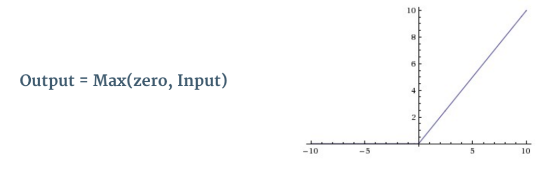
Convolutional Neural Networks
Page:17
Main concepts in ConvNets architecture:
Non-linearity (ReLU)
Convolution operation in ConvNet is
linear. To enable neural network to model
more complex concepts, we need
Non-linearity. We can use any
non-linear function such as Sigmoid
or tanh, but Rectified Linear Unit (ReLU)
has been shown to work best
for ConvNets.
ReLU is a non-linear operation.
ReLU replaces all negative values
in the feature maps with zeros.
ReLU function

Slide 19
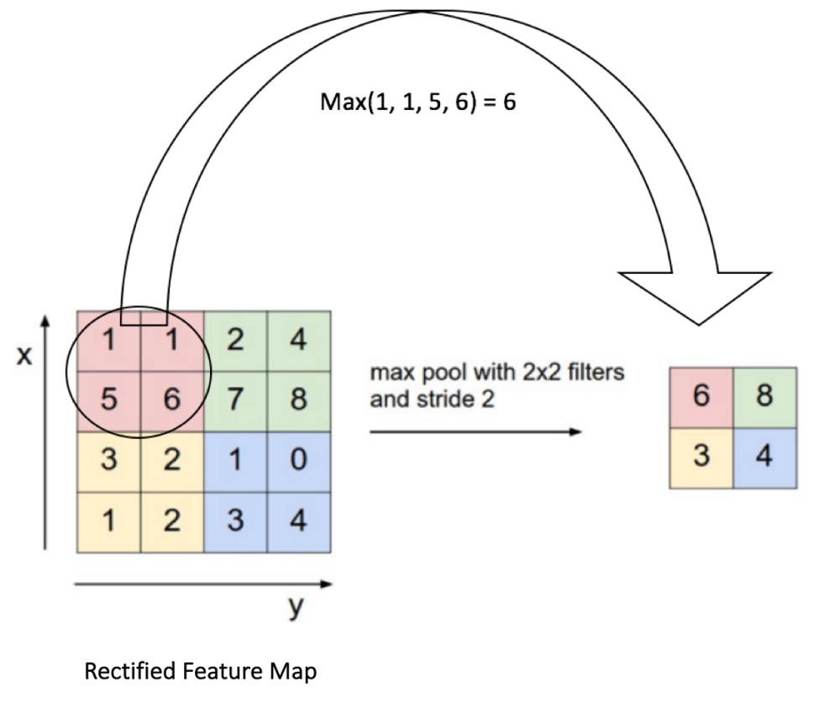
Convolutional Neural Networks
Page:18
Main concepts in ConvNets architecture:
Pooling (subsampling or downsampling) layer

Slide 20
Convolutional Neural Networks
Page:19
Main concepts in ConvNets architecture:
Fully connected layers and decision layer.
It is very common to add one (or more) fully connected hidden layers after
all convolution and pooling layers. Adding these layers can help to improve
the performance of the neural network model.
For the classification tasks (such as image/sentence classification or sentiment analysis) usually
the last layer of the ConvNet is a fully connected layer with a softmax activation function.
This layer is usually called the decision or classification layer.

Slide 21
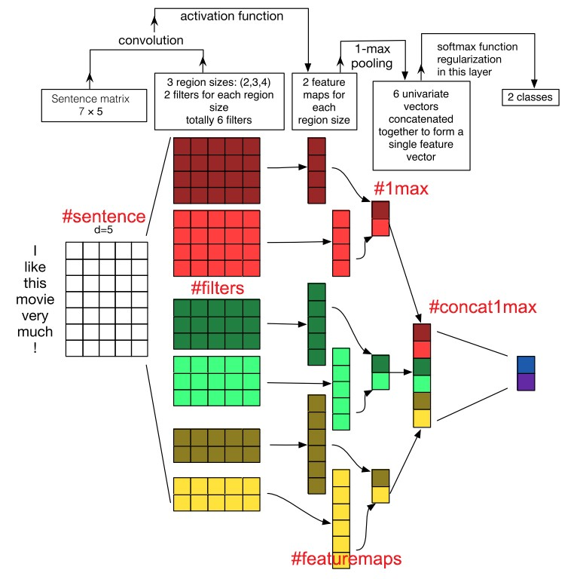
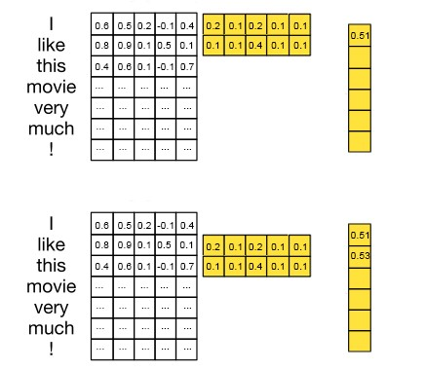
CNNs for textual data
Page:20
Sliding window (length = 2 or 3 or 4)
Sentence = W₁ W₂ W₃ W₄ W₅ W₆ W₇… W_{n}

Slide 22
CNNs for textual data
Page:21
CNNs with text:
Word-level CNN: treats each sentence as a sequence of words, and uses word-embeddings to represent each word of the language.
Character-level CNN: treats each sentence as a sequence of characters, and uses character-embeddings to represent each character of the language.
Hybrid: a combination of word-level and character-level convolutional layers are trained simultaneously in the same neural network model. Usually their final outputs (after pooling) are concatenated and used as full sentence representation.

Slide 23
What do filters learn?
Page:22
Example:
See: https://github.com/TurkuNLP/Deep_Learning_in_LangTech_course/blob/master/cnn_filters.ipynb
(cherry picked! )
Kernel 2:
incredibly unconvincing | extremely uninteresting | incredibly underwhelming | extremely lame | incredibly lame | incredibly lame | extremely forgettable | such lame | incredibly dull | equally uninteresting
Hypothetical maximum activation 2: extraordinarily unconvincing [0.55913895 0.7739633 ]
Kernel 16:
worst scripts | abysmal script | worst directed | worst acting | worst acting | worst acting | worst acting | worst acting | worst acting | worst directing
Hypothetical maximum activation 16: worst script [1.4046819 1.1285478]
Kernel 20:
perfect job | perfect job | exquisite job | perfect performance | perfect performance | perfect choice | perfect choice | perfect leisurely | perfect setup | perfect bumbling
Hypothetical maximum activation 20: perfect job [1.1471363 0.84628254]

Slide 24
What do filters learn?
Page:23
Example:
See: https://github.com/TurkuNLP/Deep_Learning_in_LangTech_course/blob/master/cnn_filters.ipynb
(cherry picked! )
Kernel 22:
highly underrated | highly underrated | Highly recommended | Highly recommended | Highly recommended | Highly recommended | Highly recommended | Highly recommended | Highly recommended | Highly recommended
Hypothetical maximum activation 22: Highly marvel [0.8886521 0.8831722]
Kernel 29:
worst flick | worst directed | worst directing | worst acting | worst acting | worst acting | worst acting | worst acting | worst acting | worst movie
Hypothetical maximum activation 29: worst Designed [1.3719323 0.483525 ]
Kernel 38:
abysmal script | poor script | poor script | poor script | poor script | poor script | lousy script | awful script | awful script | awful screenplay
Hypothetical maximum activation 38: abysmal Developed [0.85603905 0.658161 ]

Slide 25
References (1/2)
1. https://www.datacamp.com/community/tutorials/convolutional-neural-networks-python#cnn
2. https://en.wikipedia.org/wiki/Convolutional_neural_network
3. http://www.deeplearningbook.org/
4. https://cs.stanford.edu/people/karpathy/neuraltalk2/demo.html
5. http://www.aclweb.org/anthology/D14-1181
6. http://ufldl.stanford.edu/tutorial/supervised/ConvolutionalNeuralNetwork/
7. http://cs231n.github.io/convolutional-networks/
8. https://ujjwalkarn.me/2016/08/11/intuitive-explanation-convnets/
9. https://cs.nyu.edu/~fergus/tutorials/deep_learning_cvpr12/
10. http://www.wildml.com/2015/11/understanding-convolutional-neural-networks-for-nlp/
11. https://arxiv.org/pdf/1502.01710.pdf
12. http://www.aclweb.org/anthology/P16-1101
13. http://www.aclweb.org/anthology/W17-4118
14. http://www.aclweb.org/anthology/P15-1128
15. https://www.aclweb.org/anthology/K15-1013
16. http://ieeexplore.ieee.org/document/7793761/?reload=true
17. https://arxiv.org/pdf/1705.03122.pdf
18. https://cs224d.stanford.edu/reports/LambAndrew.pdf
19. https://www.microsoft.com/en-us/research/wp-content/uploads/2016/02/CNN_ASLPTrans2-14.pdf

Slide 26
References (2/2)
20. https://scholar.colorado.edu/cgi/viewcontent.cgi?article=1128&context=csci_gradetds
21. https://arxiv.org/pdf/1709.06429.pdf
22. http://www.aclweb.org/anthology/W17-2302
23. https://www.ncbi.nlm.nih.gov/pmc/articles/PMC4752975/
24. http://ieeexplore.ieee.org/document/7822671/

